Slide 1
Recommendation System
Nirajan Bekoju

Slide 2
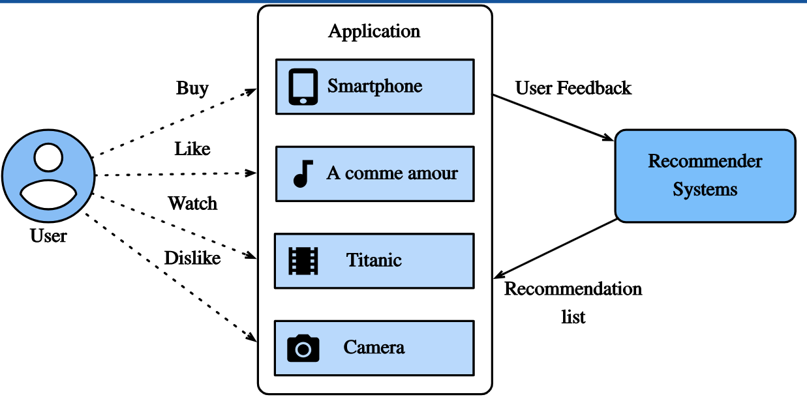
Recommendation System
A recommendation system (or recommender system) is a class of machine learning that uses data to help predict, narrow down, and find what people are looking for among an exponentially growing number of options.

Slide 3


Slide 4


Slide 5
Terminology
Items: The entities a system recommends.
For youtube: videos are items
For play store, apps are items
Query: The information a system uses to make recommendation
User Information
User id
Items that users previously interacted with
additional context
time of day
the user’s device

Slide 6
Youtube
Recommender
System
Youtube
Recommender
System
Youtube
Recommender
System

Slide 7
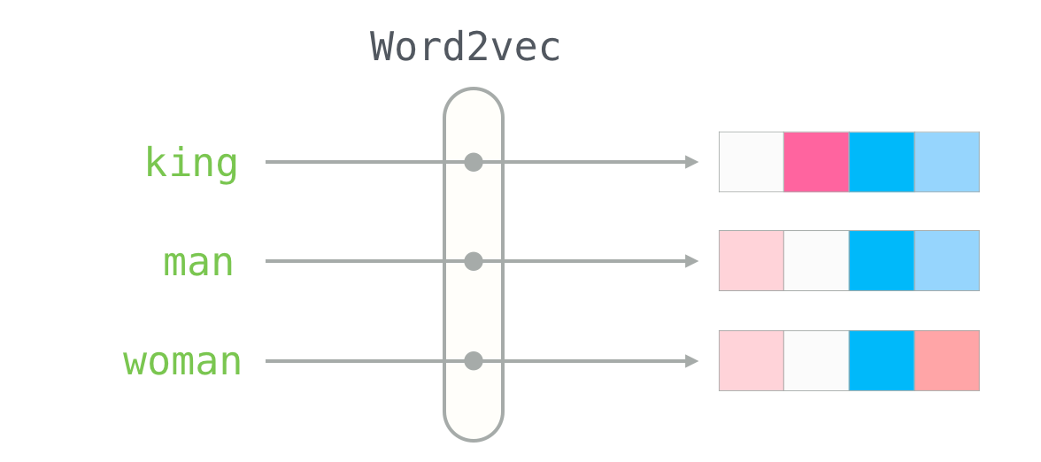
Embedding
Mapping from a discrete set to a vector space

Slide 8
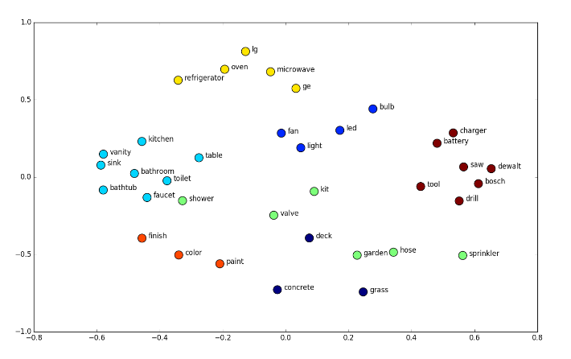

Slide 9
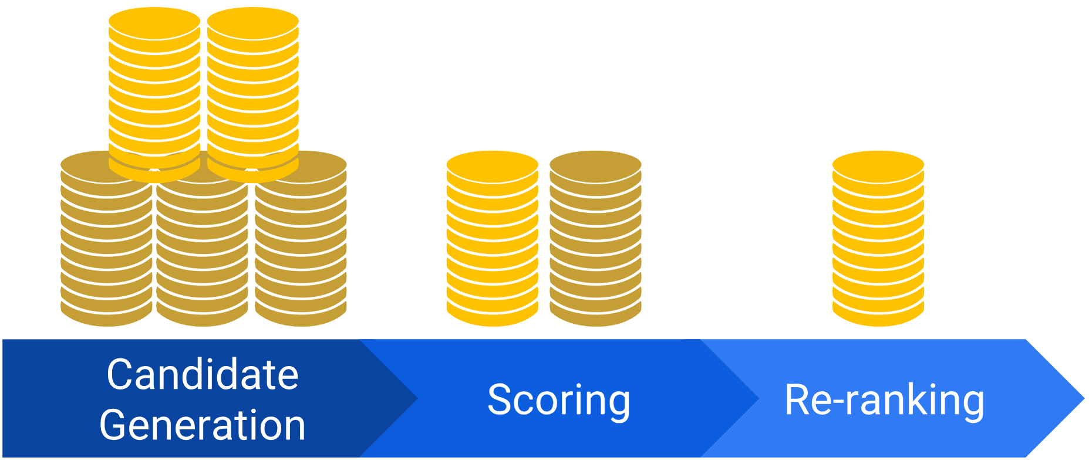
Recommendation Systems Architecture Overview

Slide 10
Candidate Generation
The system starts from a potentially huge corpus and generates a much smaller subset of candidates.
A given model may provide multiple candidate generators, each nominating a different a subset of candidates.

Slide 11
Scoring
This model scores and ranks the candidates in order to select the set of items (on the order of 10) to display to the user.

Slide 12
Re-ranking
The system must take into account additional constraints for the final ranking.
The system removes items that the user explicitly disliked or boosts the score of fresher content.

Slide 13
References
https://developers.google.com/machine-learning/recommendation
https://jalammar.github.io/illustrated-word2vec/
https://neptune.ai/blog/word-embeddings-guide

